Slide 1



Desafio de projeto
View in Power BI
Last data refresh:
01/08/2024 14:00:09 UTC
Downloaded at:
01/08/2024 14:10:18 UTC

Slide 2
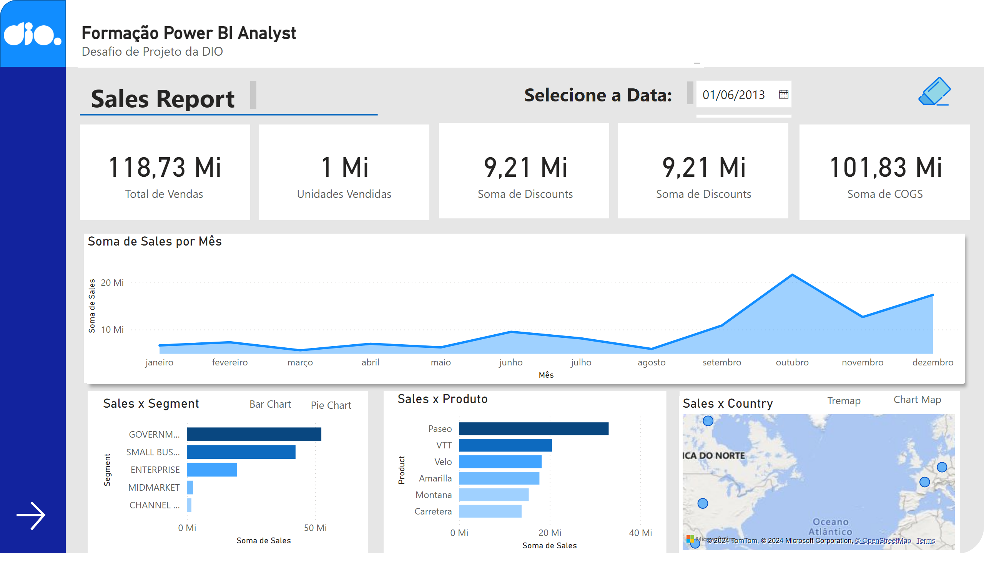
projeto_dio
Notes:
shape
No alt text provided
shape
No alt text provided
shape
No alt text provided
Logo_dio
No alt text provided
Formação Power BI Analyst
No alt text provided
Formação Power BI Analyst
No alt text provided
shape
No alt text provided
shape
No alt text provided
shape
No alt text provided
shape
No alt text provided
shape
No alt text provided
shape
No alt text provided
textbox
No alt text provided
shape
No alt text provided
shape
No alt text provided
shape
No alt text provided
shape
No alt text provided
Clean
No alt text provided
actionButton
No alt text provided
slicer
No alt text provided
textbox
No alt text provided
areaChart
No alt text provided
card
No alt text provided
card
No alt text provided
card
No alt text provided
card
No alt text provided
card
No alt text provided
Sales x Produto
No alt text provided
Sales x Segment
No alt text provided
Pie Chart
No alt text provided
Bar Chart
No alt text provided
donutChart
No alt text provided
Sales x Country
No alt text provided
treemap
No alt text provided
Tremap
No alt text provided
Map Chart
No alt text provided
actionButton
No alt text provided

Slide 3
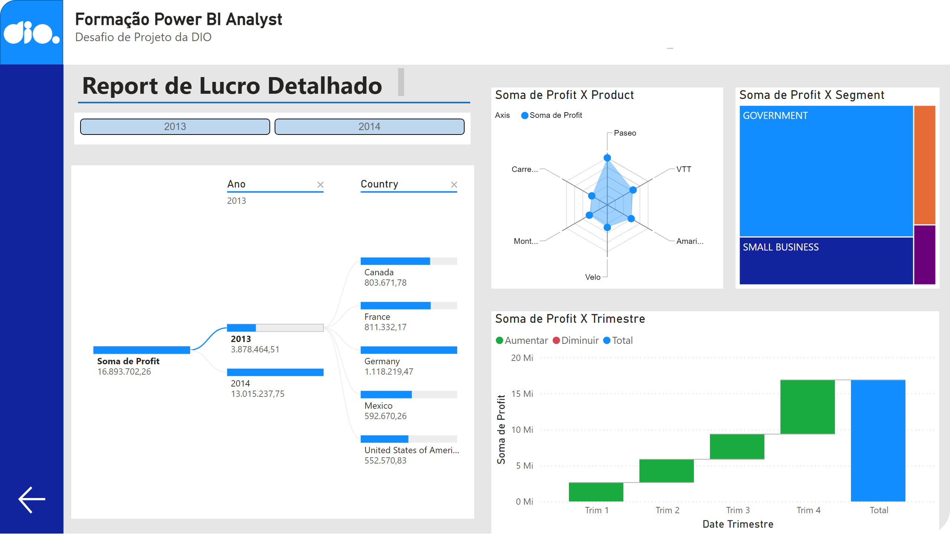
desafio_do_projeto
Notes:
shape
No alt text provided
Logo_dio
No alt text provided
Formação Power BI Analyst
No alt text provided
shape
No alt text provided
shape
No alt text provided
actionButton
No alt text provided
Soma de Profit X Product
No alt text provided
decompositionTreeVisual
No alt text provided
Soma de Profit X Trimestre
No alt text provided
Soma de Profit X Segment
No alt text provided
ChicletSlicer1448559807354
No alt text provided
Formação Power BI Analyst
No alt text provided
textbox
No alt text provided
shape
No alt text provided

